Slide 1
An Enemy of the People

Slide 2
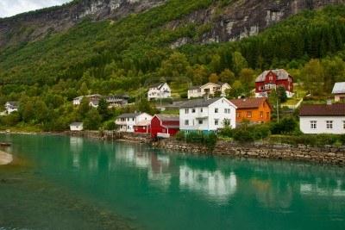
Welcome!
Image source: us.123rf.com
This small Norwegian town is buzzing with the new addition of Kirsten Springs, a health center of sorts with clear, healing water.

Slide 3
The Stockman Family
Dr. Tom Stockman-
Town Physician
Brothers
Peter Stockman-Mayor
Mrs. Catherine Stockman-
Tom’s wife.
Petra Stockman-
Tom’s eldest daughter
and a local teacher.
Morten and Ejlif-
Tom’s sons

Slide 4
Citizens of Kirsten Springs
Morten Kiil-
Catherine’s father
Aslasken-
Publisher of The People’s Daily Messenger
Captain Horster-
Ship captain and Tom’s friend.
Hovstad-
Editor of The People’s Daily Messenger
Billing-
Junior editor of The People’s Daily Messenger

Slide 5
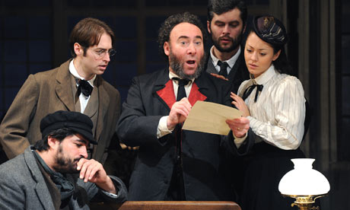
The Main Conflict
guardian.co.uk
While conducting research, Dr. Stockman discovers something about the Springs that could greatly impact the small town and his brother’s leadership, but in a negative way.

Slide 6
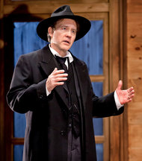
The Big question
theater.nytimes.com
Will Dr. Stockman do what is right? And if so, what is right?

