Slide 1
Journalism Ethics

Slide 2
Ethics Review
What have we learned so far about ethics?
With regards to ethics, why do you think it would be important for journalists to write in a way that shows both sides of an issue?

Slide 3
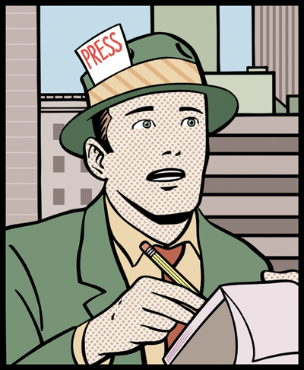
A Journalist’s Role
A journalist is the information giver in a society. They mediate between the leaders of society and the citizens. They are “watchdogs” that report truth.
norcalblogs.com

Slide 4
Elements of Journalism
Journalism's first obligation is to the truth.
Its first loyalty is to citizens.
Its essence is a discipline of verification.
Its practitioners must maintain an independence from those they cover.
It must serve as an independent monitor of power.
It must provide a forum for public criticism and compromise.
It must strive to make the significant interesting and relevant.
It must keep the news comprehensive and proportional.
Its practitioners must be allowed to exercise their personal conscience.
Source: www.journalism.org

Slide 5
Bias in Journalism
Even though journalists attempt to report the truth, bias can still appear in their writing. This usually happens because the source that they write for endorses a specific political party or a specific side of an issue.

Slide 6
Real World Example
Optimism faded when fiscal talks resumed; 31 days remain until deadline
“The post-election negotiations on U.S. deficit reduction that began with a surge of optimism sputtered this week with Republicans expressing political indignation over President Obama’s opening offer to keep a $500 billion mix of tax hikes and federal spending cuts from kicking in next month should no deal be reached.”
Source: FOX News
Obama aides seek to counter Republican charges
“The Obama administration sought to counter Republican charges on Friday that President Barack Obama's plan to avoid a year-end ‘fiscal cliff’ is light on spending cuts and too reliant on tax increases.”
Source: NBC News

Slide 7
Identifying Bias
What words are used that could help you find the journalists’ biases?
What could be the benefit of looking to more than one source for information?

